Slide 1

COVID 19 FOOD SURVEY
A DATA SCIENCE – INSIGHTS OVERVIEW

Slide 2
AGENDA
✓ Introduction
✓ Problem Statement and Data Source
✓ Objective & Methodology
✓ Solution Description
✓ Impactful Insights

Slide 3
INTRODUCTION
COVID19 Food Survey is basically a survey to collect data of the preferred food item by COVID patients that are recovering or recently recovered from the infection.
This survey is targeted to generate impactful insights related to COVID patients’ diet structure.

Slide 4
Problem Statement & Data Source
To understand the trend of food intake by COVID patients, based on various parameters like Region, Age, etc.
Generate impactful insights that can help in guiding patients in better recovery.
Data is collected via a Google Survey Form, generating 100 entries.

Slide 5

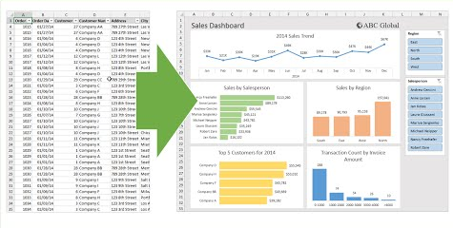
Objective & Methodology
Identify
Identify frequent food intake items by COVID patients.
Visualize
Visualize the pattern of COVID spread throughout demography.
Generate
Generate insights to help COVID patients recover better and faster.

Slide 6
Solution Description
Analyzing the data obtained, by first arranging the data then cleaning it for further analysis by Visualization.
Studying Pivot Charts to generate points to connect various parameters of survey.
Generating solutions to probable queries related to survey via Insight predictions.

Slide 7
Frequency Distribution of COVID patients across different Regions.
As shown in the Stacked Column chart :
Northern Region has Most COVID patients as per the survey.
Eastern Region has the Least COVID patients as per the survey.

Slide 8
2. Frequency Distribution of Affected Age Groups.
As can be seen from the bar graph on side :
Age group most affected by COVID :
40-50 yrs.
Age Group least affected by COVID :
20-30 yrs.

Slide 9
3. Percentage Distribution of COVID patients.
As shown in the Donut Chart on the side :
Male is the most affected gender.
Other (excluding Male & Female), is the least affected gender.

Slide 10
Impactful Insights
Antioxidants rich Green Tea is helpful in recovery process of Covid patients.
Protein intake preferences (whether Veg or Non Veg) can be seen as a major insight by this survey.
Males could have a lesser immunity than Females, acc to survey.
Pulses and Salads are crucial for a faster recovery.

Slide 11
Thank You
For your Attention
PALLAVI RAJAN

